Slide 1

Version Control: Git
Electronics Lab
Smead Aerospace Engineering Sciences Dept.

Slide 2
What is Version Control?
Overview/Description
Version control is managing changes to computer programs, documents, large web sites, or other collections of information
Version control systems are software tools that help software teams manage changes to source code over time
Version control software keeps track of every modification to the code base
Creates an agile software development environment.
Required for multiple people working on the same code

Slide 3







Flavors of Version Control
Examples
Git
GitHub
GitLab
GitKraken
Mercurial
CVS
SVN

Slide 4
What is Git?
Overview
Git is a free and open source distributed version control system designed to handle everything from small to very large projects with speed and efficiency.
One of the most widely used version control systems
Contains many essential features used for version control
Easy to learn and very straightforward

Slide 5
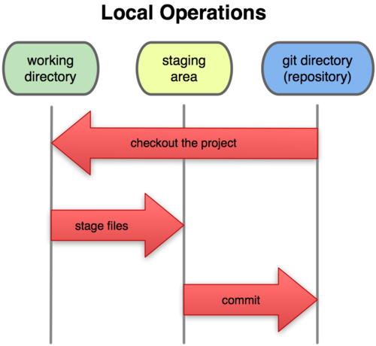
What is Git?
Structure:
Repo Manager (GitHub, etc…)
Repositories
Branches
Working directory (work)
Staging area (stage)
Commits (save)
Pull Requests!
Merging

Slide 6
GitHub
Go to GitHub.com
Create an account with your preferred email address*
*Login to your account if you already have one
Tell the instructor your username so they can add you to the repository
Accept the repository invite the instructor will send you

Slide 7
General Workflow & Commands
Cloud storage on GitHub.com
Remote
Repository
Cloud
Push
Local
Repository
Your local file storage
(Local warehouse)
Commit
Fetch
Your outbox from where you
ship changes you created locally
Staging
Area
On your Computer
Add
Your Workbench where you
add/edit/remove what you're working on
Working
Directory
Merge
Pull

Slide 8
General Workflow & Commands
Repository
The main storage area for every branch, file , etc…
Picture a big bucket for all of your code/organizational structure
Can be constructed locally via a terminal
Can be confusing using this method
More commonly created using a remote source
GitLab, GitKraken, GitHub, etc….
Remote: a cloud-based collaborative location for your repository
Different types of repositories
Public Vs. Private
Different Licenses

Slide 9
Installing Git
Please install both of the following:
Git Bash terminal:
https://git-scm.com/downloads
GitHub Desktop:
https://desktop.github.com/
Optional: Visual Studio Code
https://code.visualstudio.com/

Slide 10
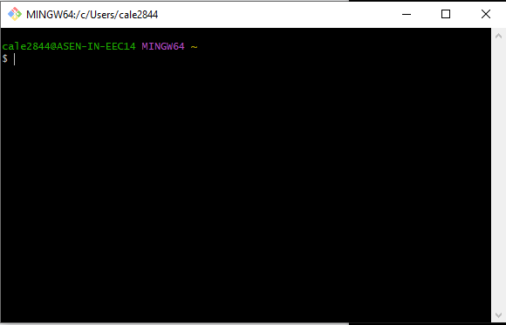
How to git: Option 1 Git Bash
“What is the console (or terminal)?”
The console gives the user root access to all files via bash commands
In English: Command-line interface for controlling file structure
Can view, move, delete, and create files anywhere on your computer.

Slide 11
Bash Commands
LS
List all files in current directory
CD <directoryPath>
Moves into listed directory
“CD ..” will move out of the current directory
MKDIR <directoryName>
Makes a new directory
TOUCH <file.Name>
Creates a new file
RM <fileOrDirectory>
Removes list file or directory
Clear
Clears the terminal screen
** add --help after any command to pull up the commands help window
This will show you all the options available for every command
Hint: all commands above also work with all lowercase letters! DON'T TYPE the < and > characters!

Slide 12
Basic Bash Command Practice
Click the Windows button on the keyboard, and type in “Git Bash”
Open the Git Bash Terminal
Type “ls” to see the contents of your current location
You should be able to see directories such as “Documents”, “Downloads”, and “Desktop”
Type “cd Desktop” to change your current working directory to “Desktop”
Type "mkdir workspace" to create a folder on your desktop called "workspace"
Type "cd w" and then hit "tab" before hitting enter to change your current working directory to “workspace”
Hint: Hit the “tab” button to autocomplete commands, filenames, etc. in the terminal

Slide 13
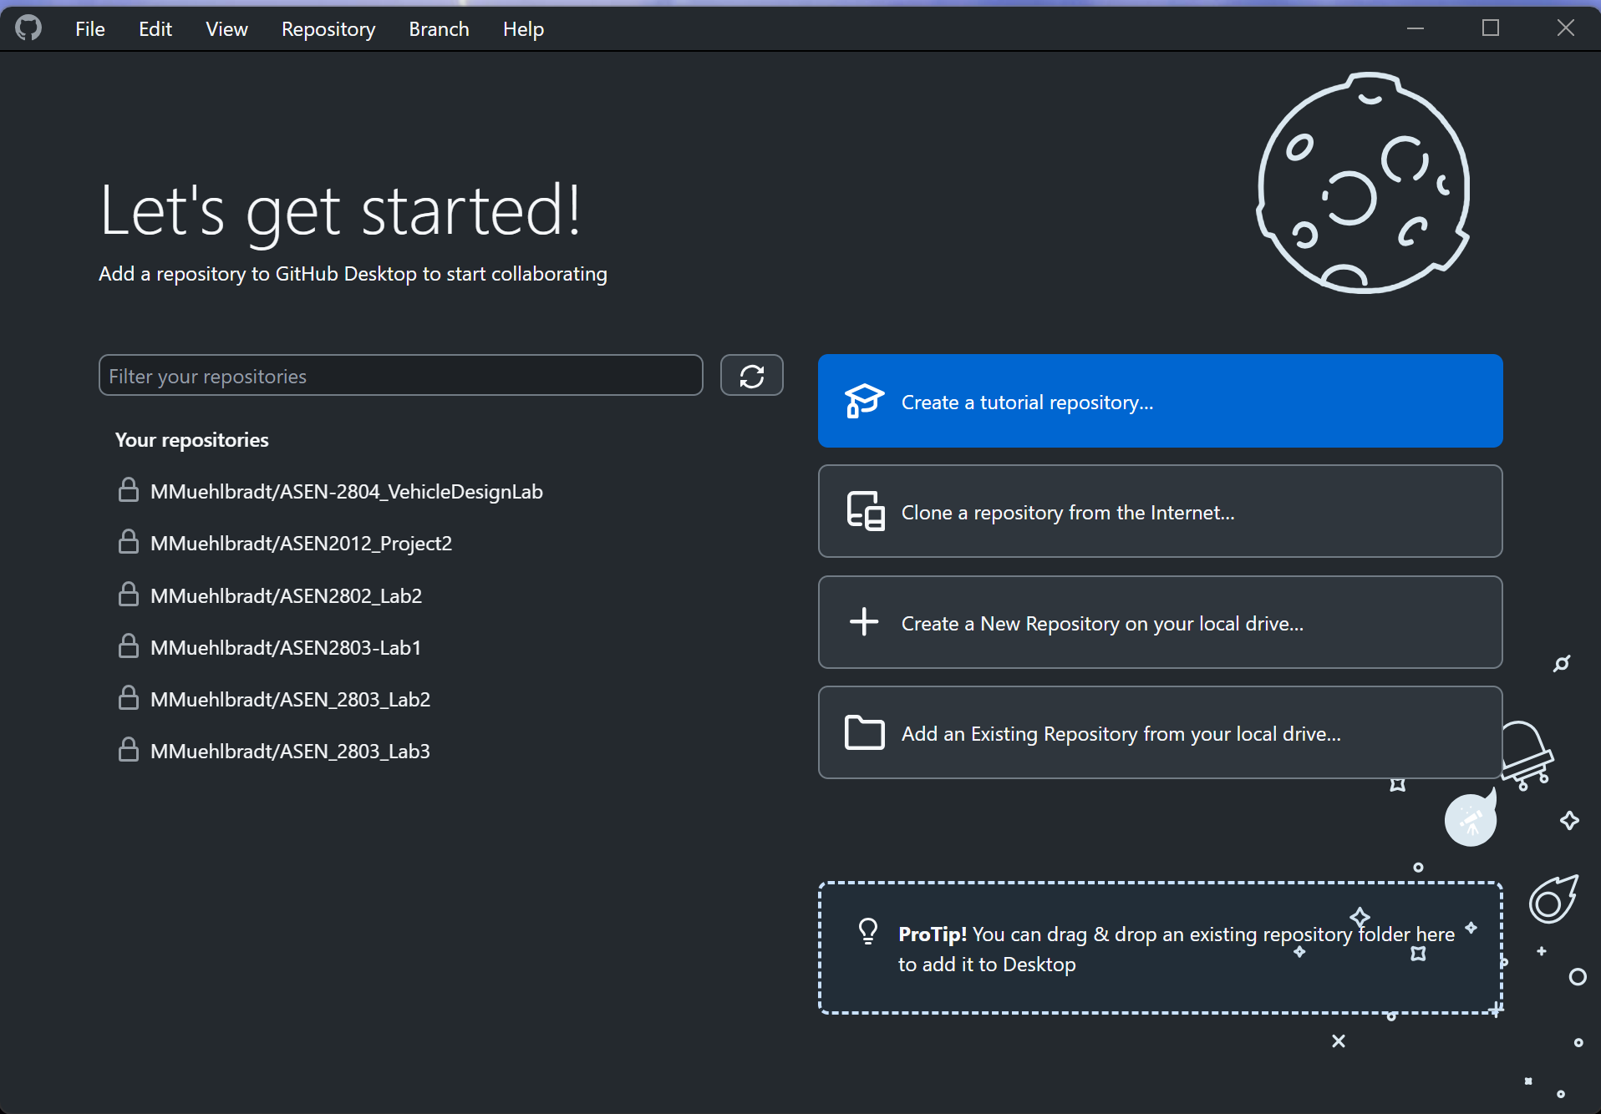
How to git: Option 2 GitHub Desktop
GUI application that works with most git cloud providers:
GitHub
GitLab
No multi-user option :(

Slide 14
General Workflow & Commands: Clone
Clone (git clone https://github.com/UCBoulder/GitWorkshop.git)
Clones (downloads) a repository to a new local directory
This new directory well be linked to the remote repository (remote-tracking)
More specifically linked to the cloned branch of the repository
This means git will now automatically track any changes inside that folder!
Create a Folder named "Workspace" or GitHubRepositories" on your computer
Make sure this folder is NOT tracked in OneDrive, Dropbox or similar. This can cause issues when using multiple computers!

Slide 15
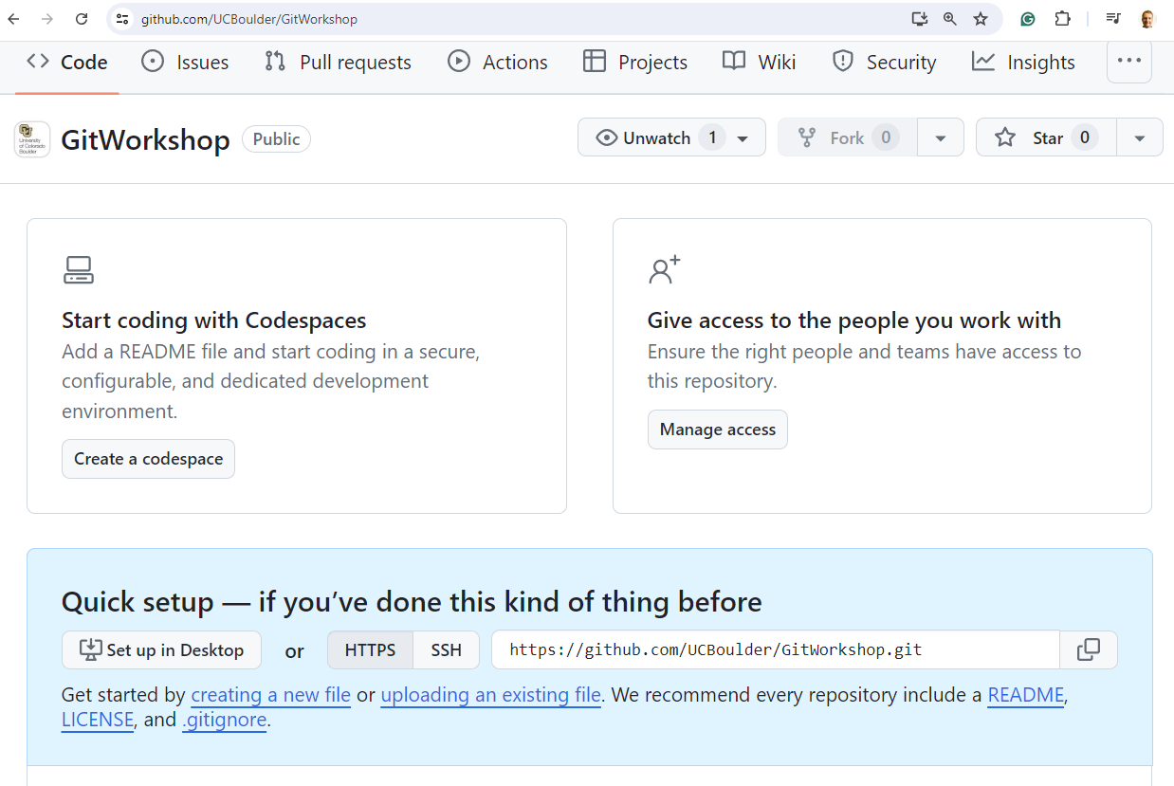
General Workflow & Commands: Clone
We'll work with the following repository for the rest of this workshop:
https://github.com/UCBoulder/GitWorkshop

Slide 16
Git Workflow & Commands: Clone
Git Bash:
Start in the "workspace folder"
Type “git clone https://github.com/UCBoulder/GitWorkshop.git”
Type “cd Git-Workshop”

Slide 17
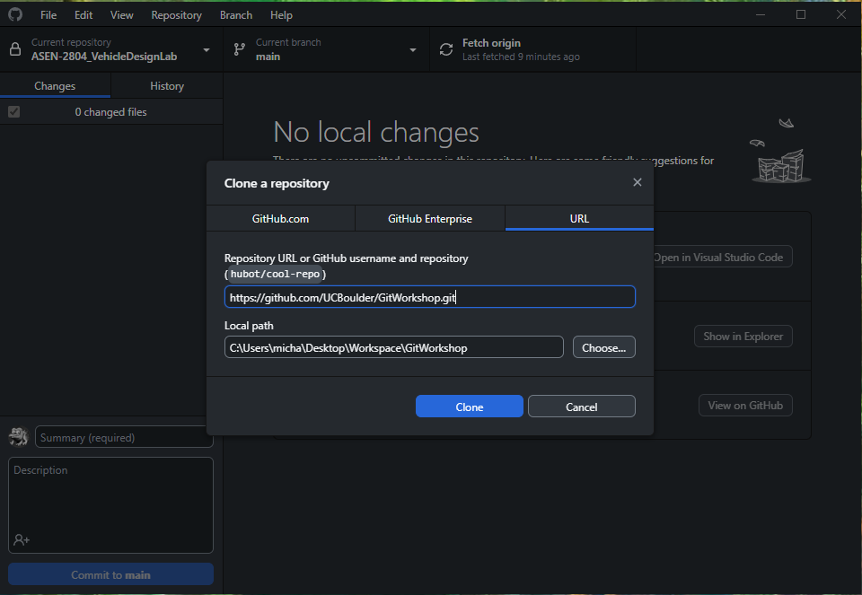
Git Workflow & Commands: Clone
GitHub Desktop:
File -> Clone Repository
Select the URL tab
Paste the URL in the top field: https://github.com/UCBoulder/GitWorkshop.git
Choose the "Workspace" folder as your local path

Slide 18
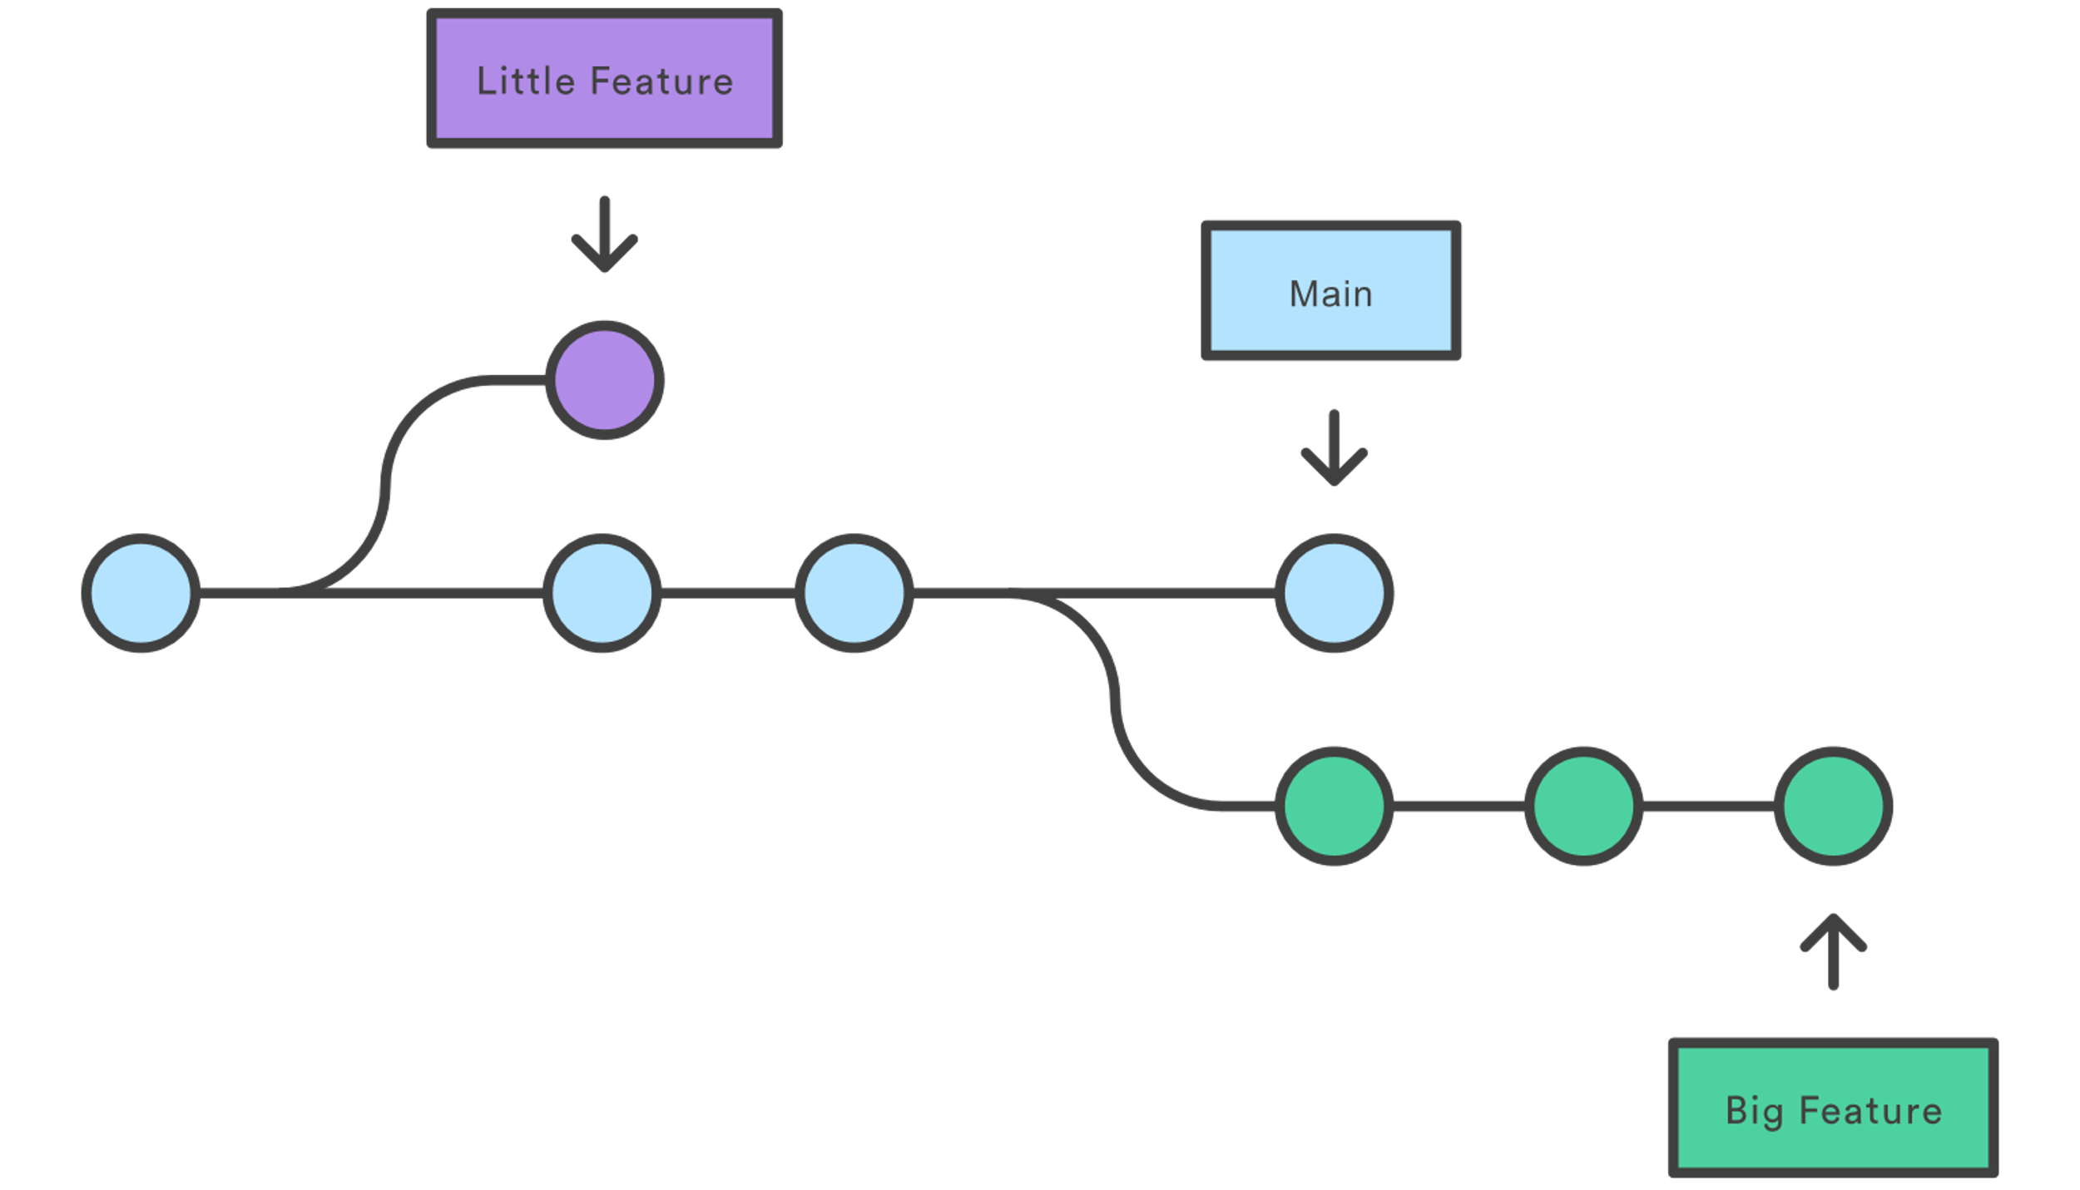
Git Workflow & Commands: Branches
Branches organize a "unit of work"
Use a branch per feature/experiment.
Ex: adding a new sensor to a copter
Ex: Fixing a bug gets its own branch
Branches contain a group of changes that can be easily reverted

Slide 19
Git Workflow & Commands: Create new branch
Git Bash:
Start in the "Git-Workshop" folder
Type “git status”
If you get an error you are in the wrong folder!
Type “git branch <identikey_Branch>”

Slide 20
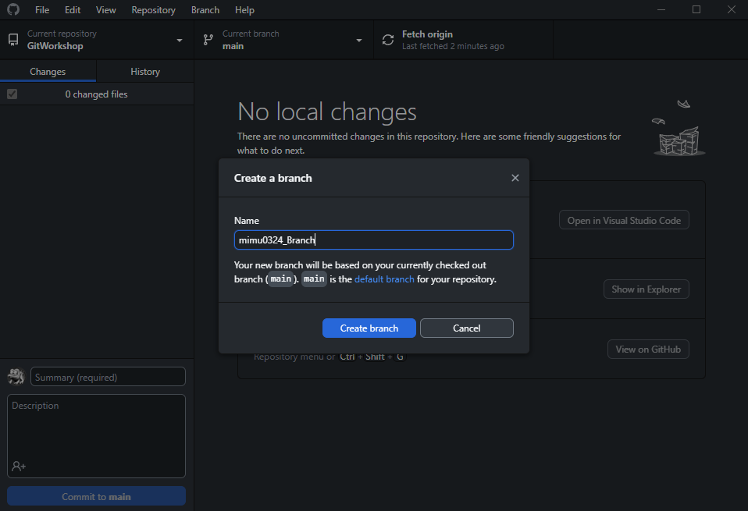
Git Workflow & Commands: Create new branch
GitHub Desktop:
Branch-> New Branch
Type in: "<YourIdentiKey>_Branch"
Create branch
Publish your branch

Slide 21
Git Workflow & Commands: Do some work
Type “touch NameTextFile.txt”
In file explorer. navigate to this file location, and open the newly created text file.
Type something!
ctrl+s to save the file
In the git repo create a new text or word file
Open the file and type something
Save the file and close Notepad/Word

Slide 22
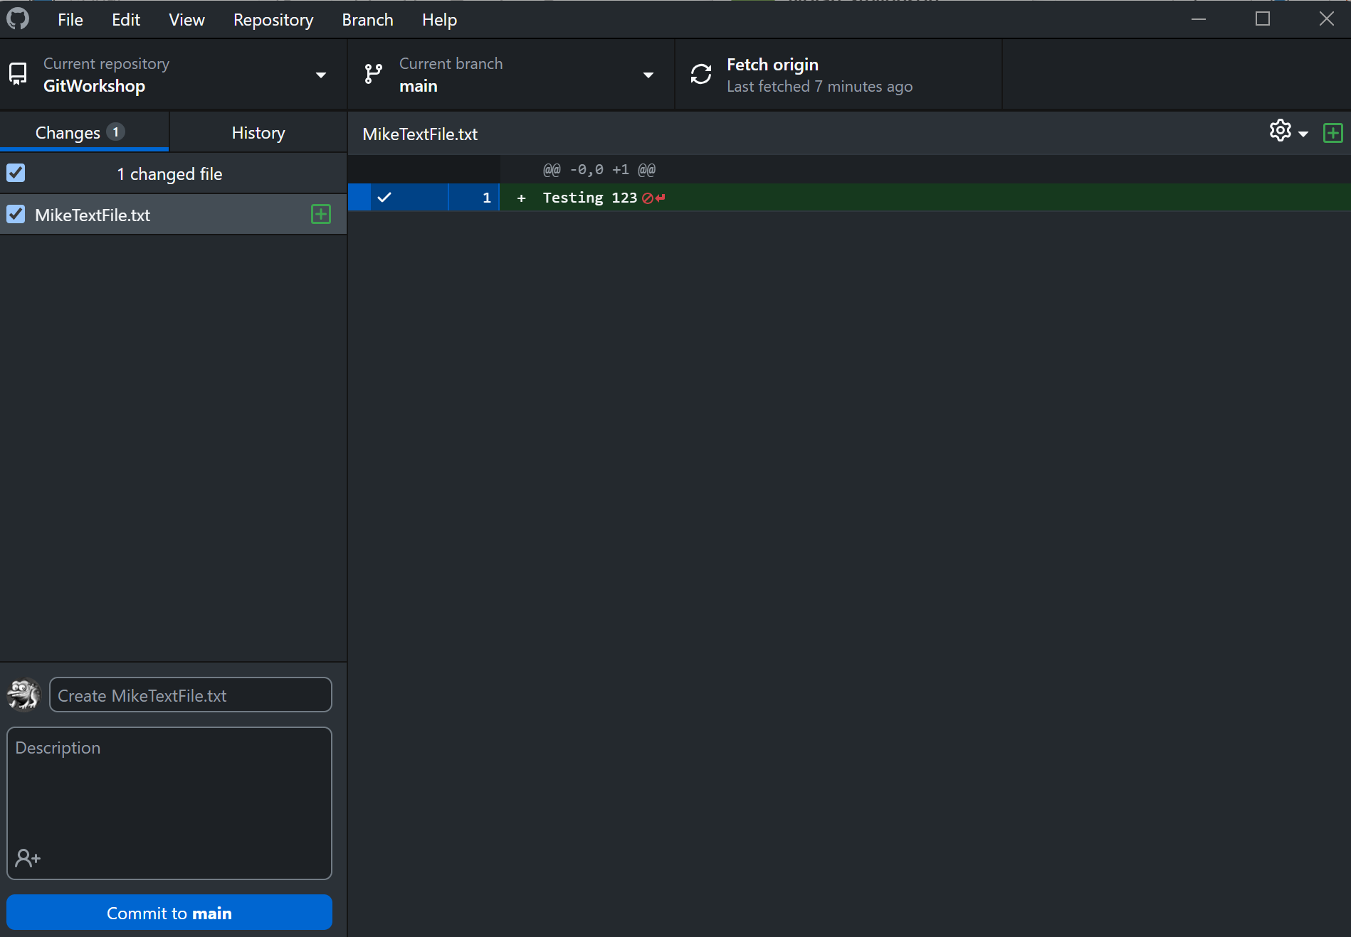
General Workflow & Commands: Add
Add (git add)
Stages all files that have been edited in your working directory
Staging a file stores all the changes and edits to an “Index”
This “Index” Is a snapshot of the most recent changes and edits
Use the commit command to finalize your changes to your local repository

Slide 23
General Workflow & Commands: Add
Follow along:
“git status”
Shows state of tracked and untracked files (in color!)
“git add NameTextFile.txt”
Stages file to be a part of the next commit
“git status”
Should now show your file name in green under the “Changes to be committed” category

Slide 24
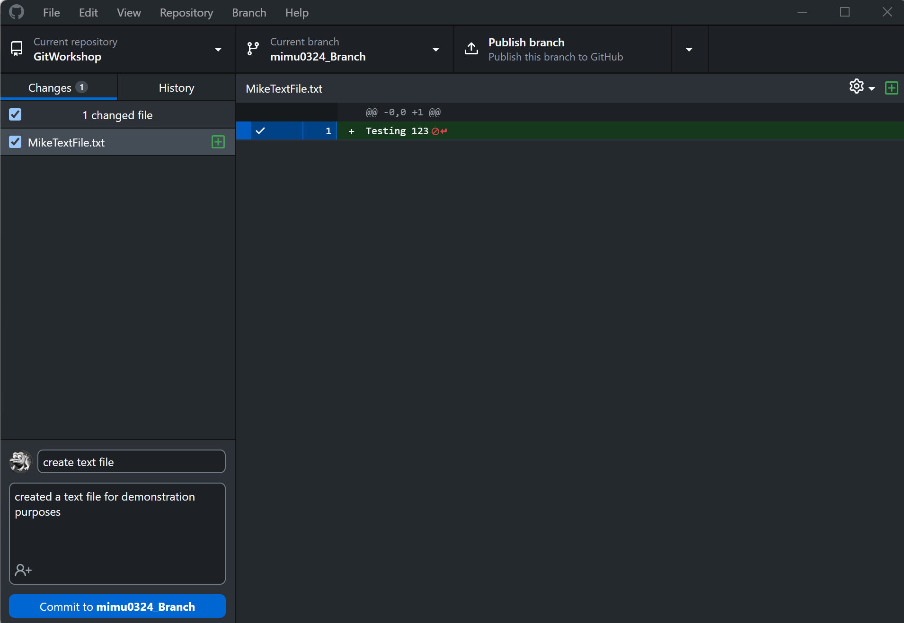
General Workflow & Commands: Commit
Commit
Commits changes to current branch
Only includes files in the staging area (files that have been added)
Content can be committed in multiple ways
by using git-add to incrementally "add" changes to the index before using the commit command
by using the -a switch with the commit command to automatically "add" changes from all known files
Follow along:
Enter a relevant comment and summary for your changes
Hit the "Commit to <BranchName>" Button

Slide 25
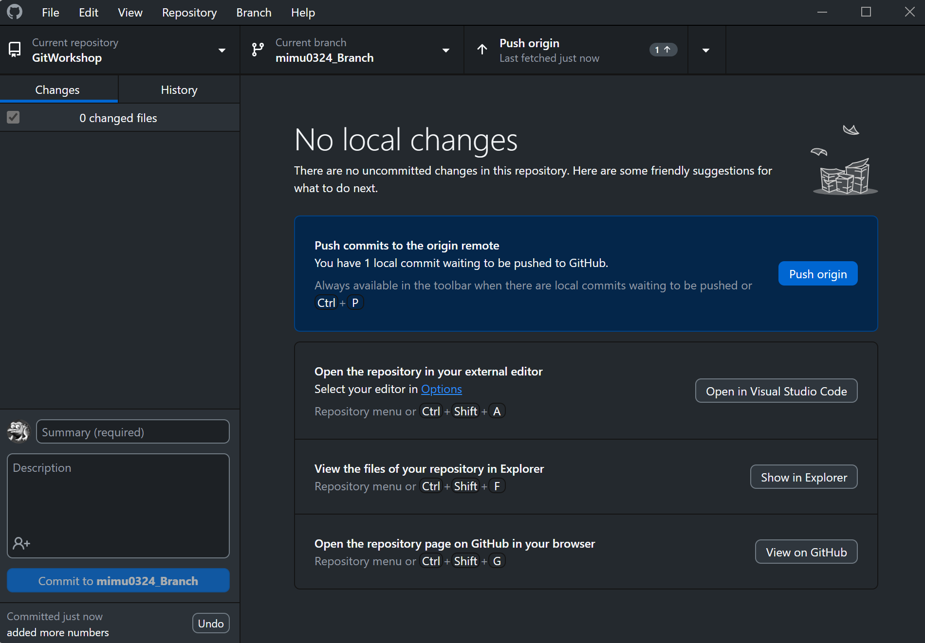
General Workflow & Commands
Push (git push)
Updates the remote branches and references
Sends files and objects to update remote branches
Used to save your changes to the remote repository

Slide 26
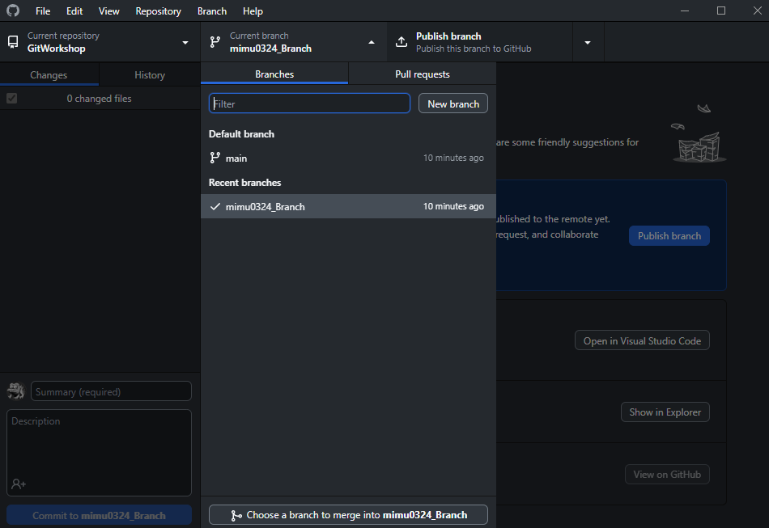
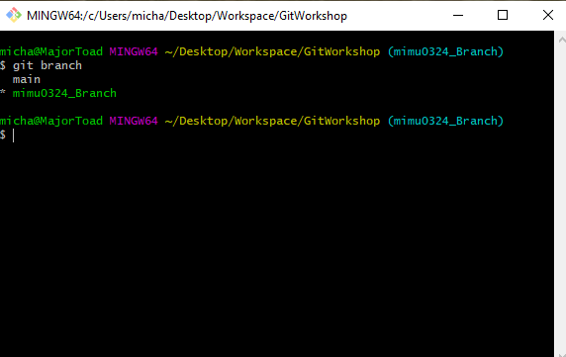
Git Workflow & Commands: Show local branches
Git Bash:
Start in the "Git-Workshop" folder
Type “git branch”
GitHub Desktop:
Branch
Notes:
Notice that you are only seeing the master branch the repo started with AND the LOCAL branch you just created! Note that GitHub Desktop will fetch data in the background ever so often, so if you wait for a while these changes may show up automatically, but DO NOT RELY ON THIS. To fix this we need to learn about fetching and pulling.

Slide 27
General Workflow & Commands: Pull
Pull (git pull)
Grabs all changes from a remote repository inserts them into your current branch
If the current branch is different from the remote repository a rebase may be required
Either a rebase or a merge to fix differences in branches

Slide 28
General Workflow & Commands: Pull
Follow along:
“git pull”
Pulls down all changes since the last time you have pulled to your current branch

Slide 29
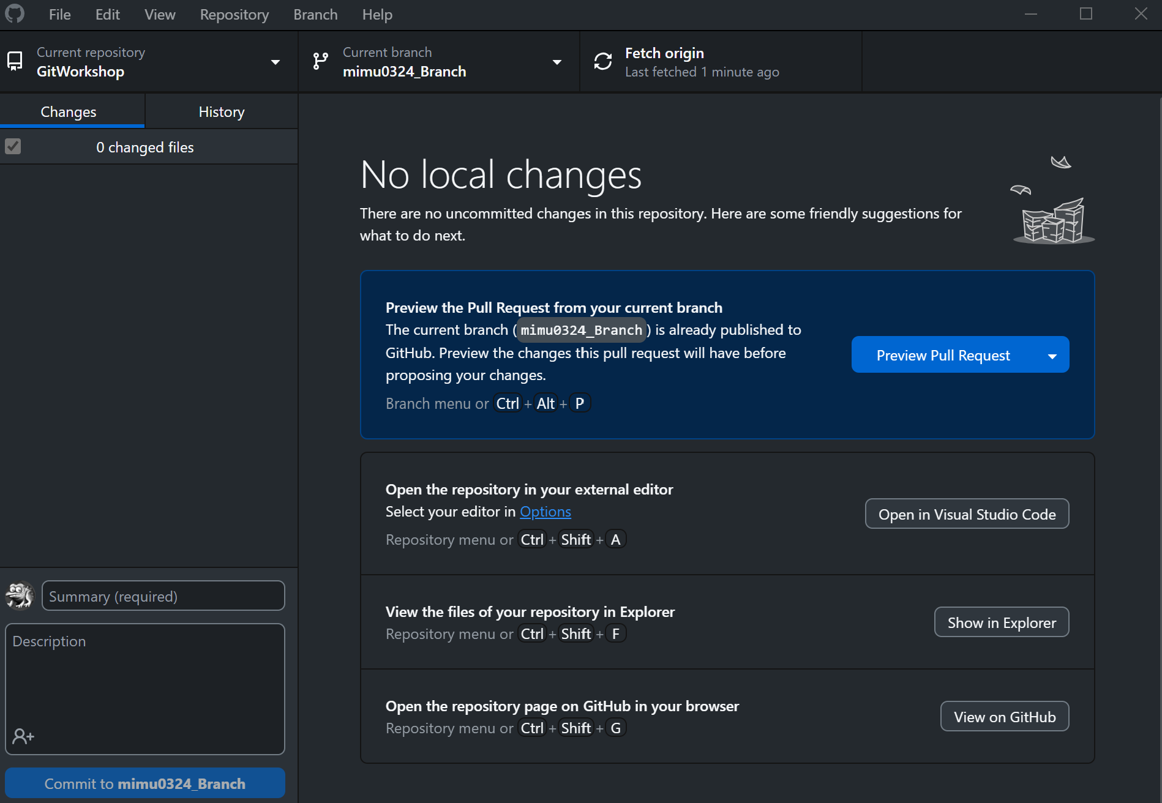
General Workflow & Commands: Fetch (Optional)
Fetch (git fetch)
Gathers branches from one or more repositories, along with the files and objects necessary to complete them
Updates remote tracking branches ***
Usually followed after a git clone

Slide 30
General Workflow & Commands: Fetch (Optional)
Fetch (git fetch)
Follow along: (optional, it will not change anything since we just pulled)
“git fetch”

Slide 31
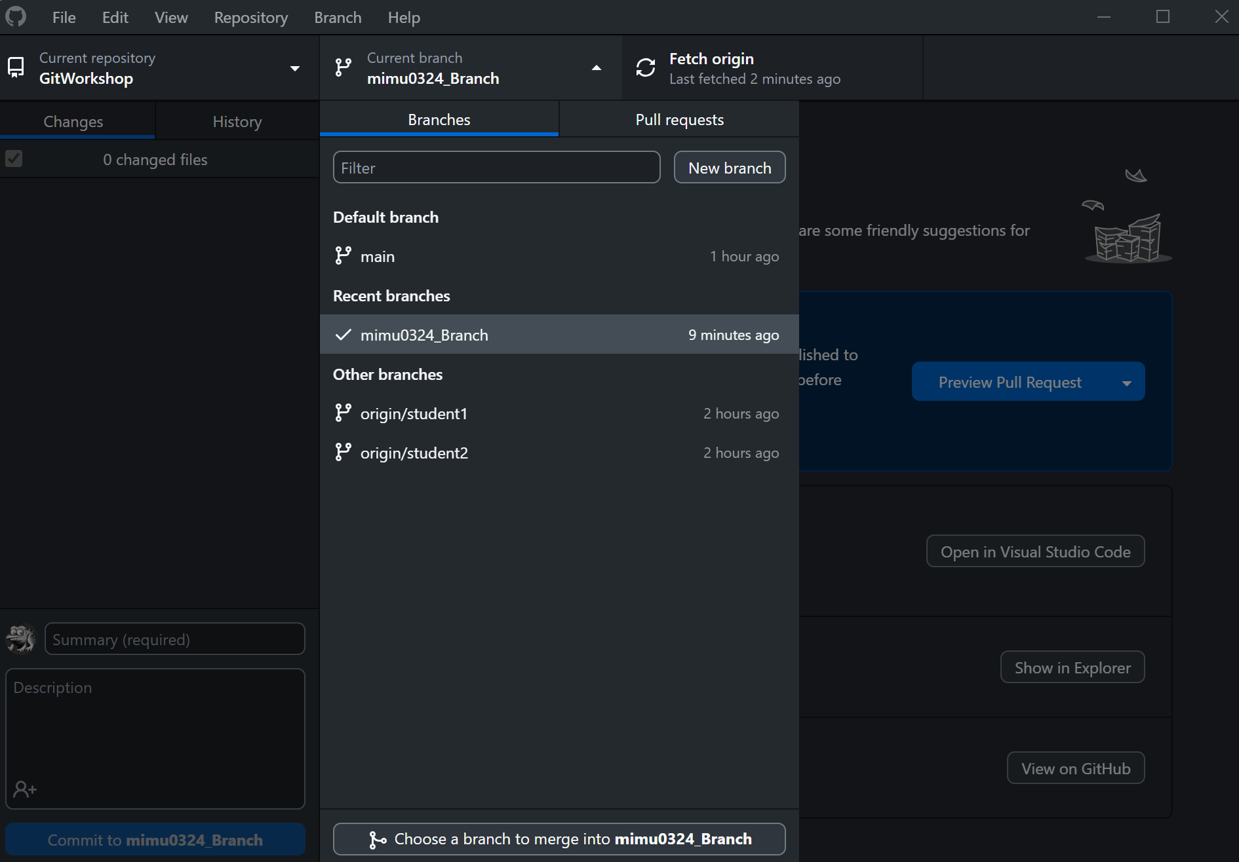
General Workflow & Commands: Checkout
Checkout (to existing branch)
“git checkout [<branch>]”
Branch (display current branches)
“git branch”
Will show a list of branches on your local repository

Slide 32
General Workflow & Commands: Checkout
Follow along:
“git checkout Names_Branch”
Creates a new branch, and sets it as your current branch
“git branch”
Displays all local branches, you should see “master” and “Name’s Branch”
Only displays branches that you have checked out previously

Slide 33
General Workflow & Commands: Pull Request
Pull Requests (via GitHub)
Pulls one branch’s changes and additions into another branch
Always have other people review pull requests to avoid merge conflicts or broken code
Merge conflicts! Yay! :/
Generally happens when people edit or change the same lines of code
Also happens when files get deleted
Almost unavoidable

Slide 34
General Workflow & Commands: Stash & Pop
Extras: Stash/Pop (When you’re not quite ready for a commit)
Stash
Saves your current changes and edits but doesn’t commit them
Reverts your working directory back to last commit
Pop
Commits the changes stored from git stash
Drops what was stored in git stash

Slide 35
Git Best Practices
Include branch name and concise message in every commit
Ex: git commit -m “branchName: Added functionality for x component”
Always have at least one reviewer for every pull request (not yourself)
Commit or stash often! This will help you track your own work & debug later (your code will break)
Only push working code to master -> The master branch should NEVER include broken code

Slide 36
Merge Conflicts and Branch Control In GitHub Desktop
Merge conflicts will happen, its important to know how to resolve them
Typically happen when the same lines of code get edited, or files get deleted
If following best practices (multiple branches for specific purposes), will generally happen when merging branches together
GitHub Desktop has built in tools for resolving these conflicts

Slide 37
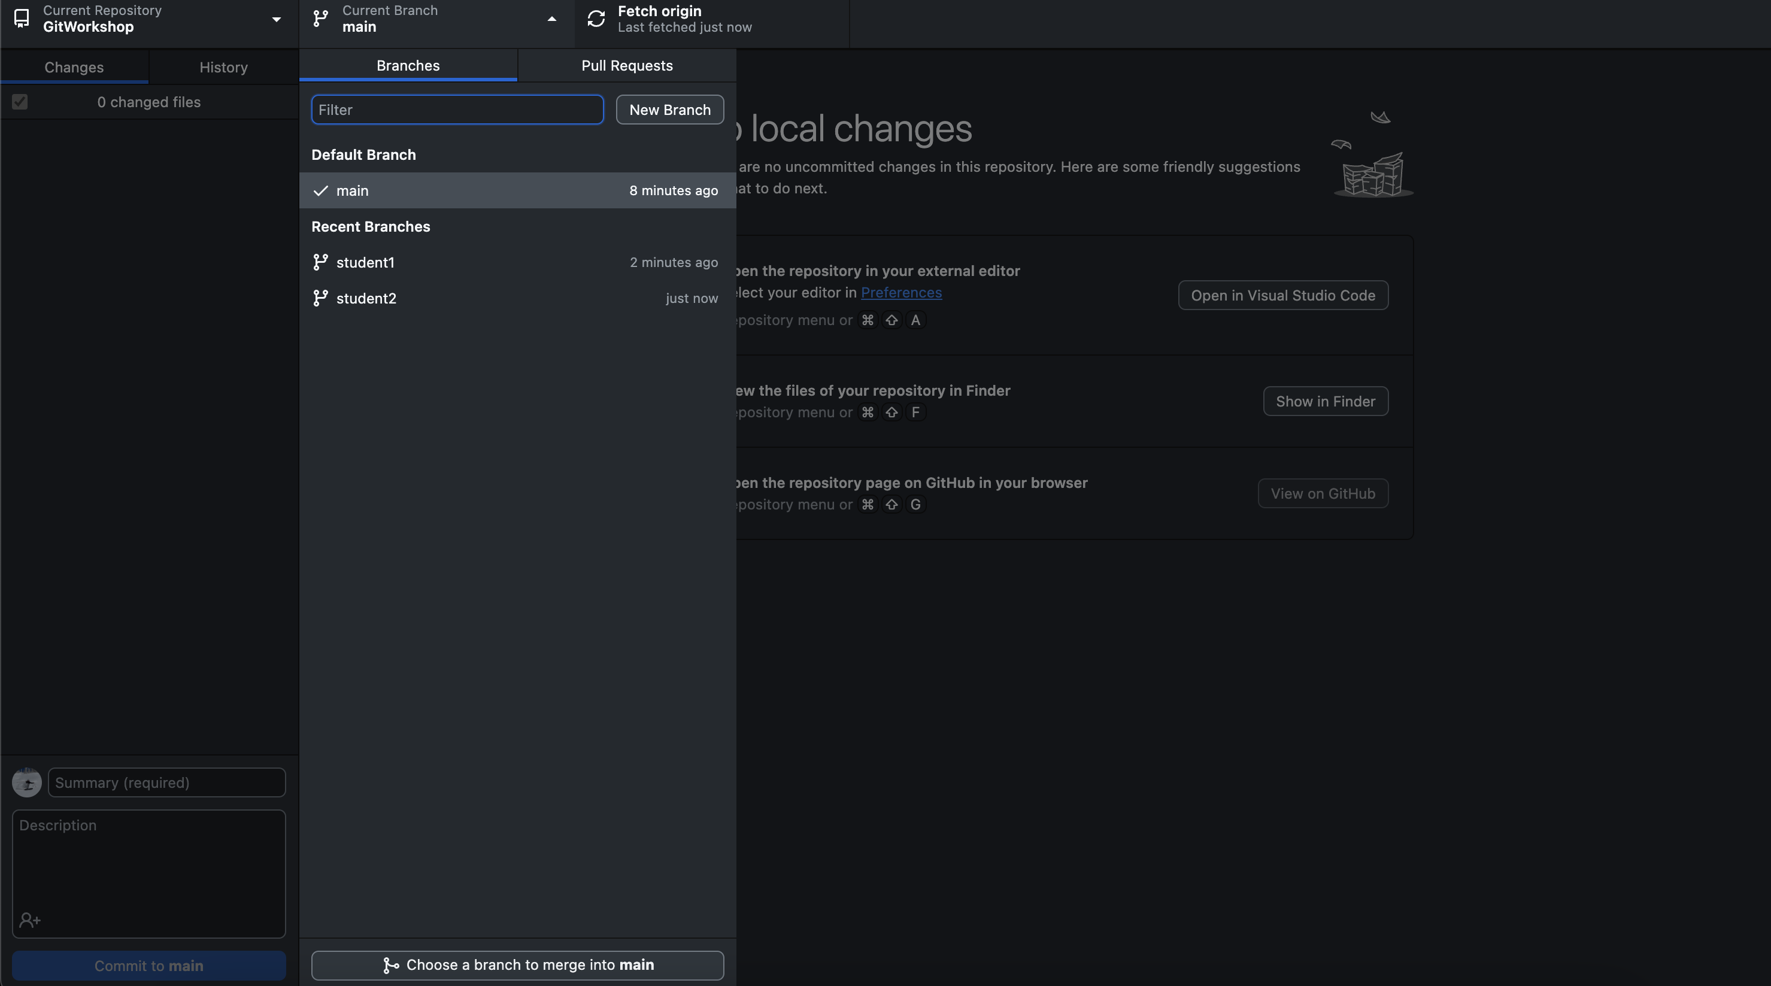
Merge Conflicts and Branch Control: Example
Example: Two students are working on two separate branches
Goal: Merge the branch “student1” into branch “main”

Slide 38
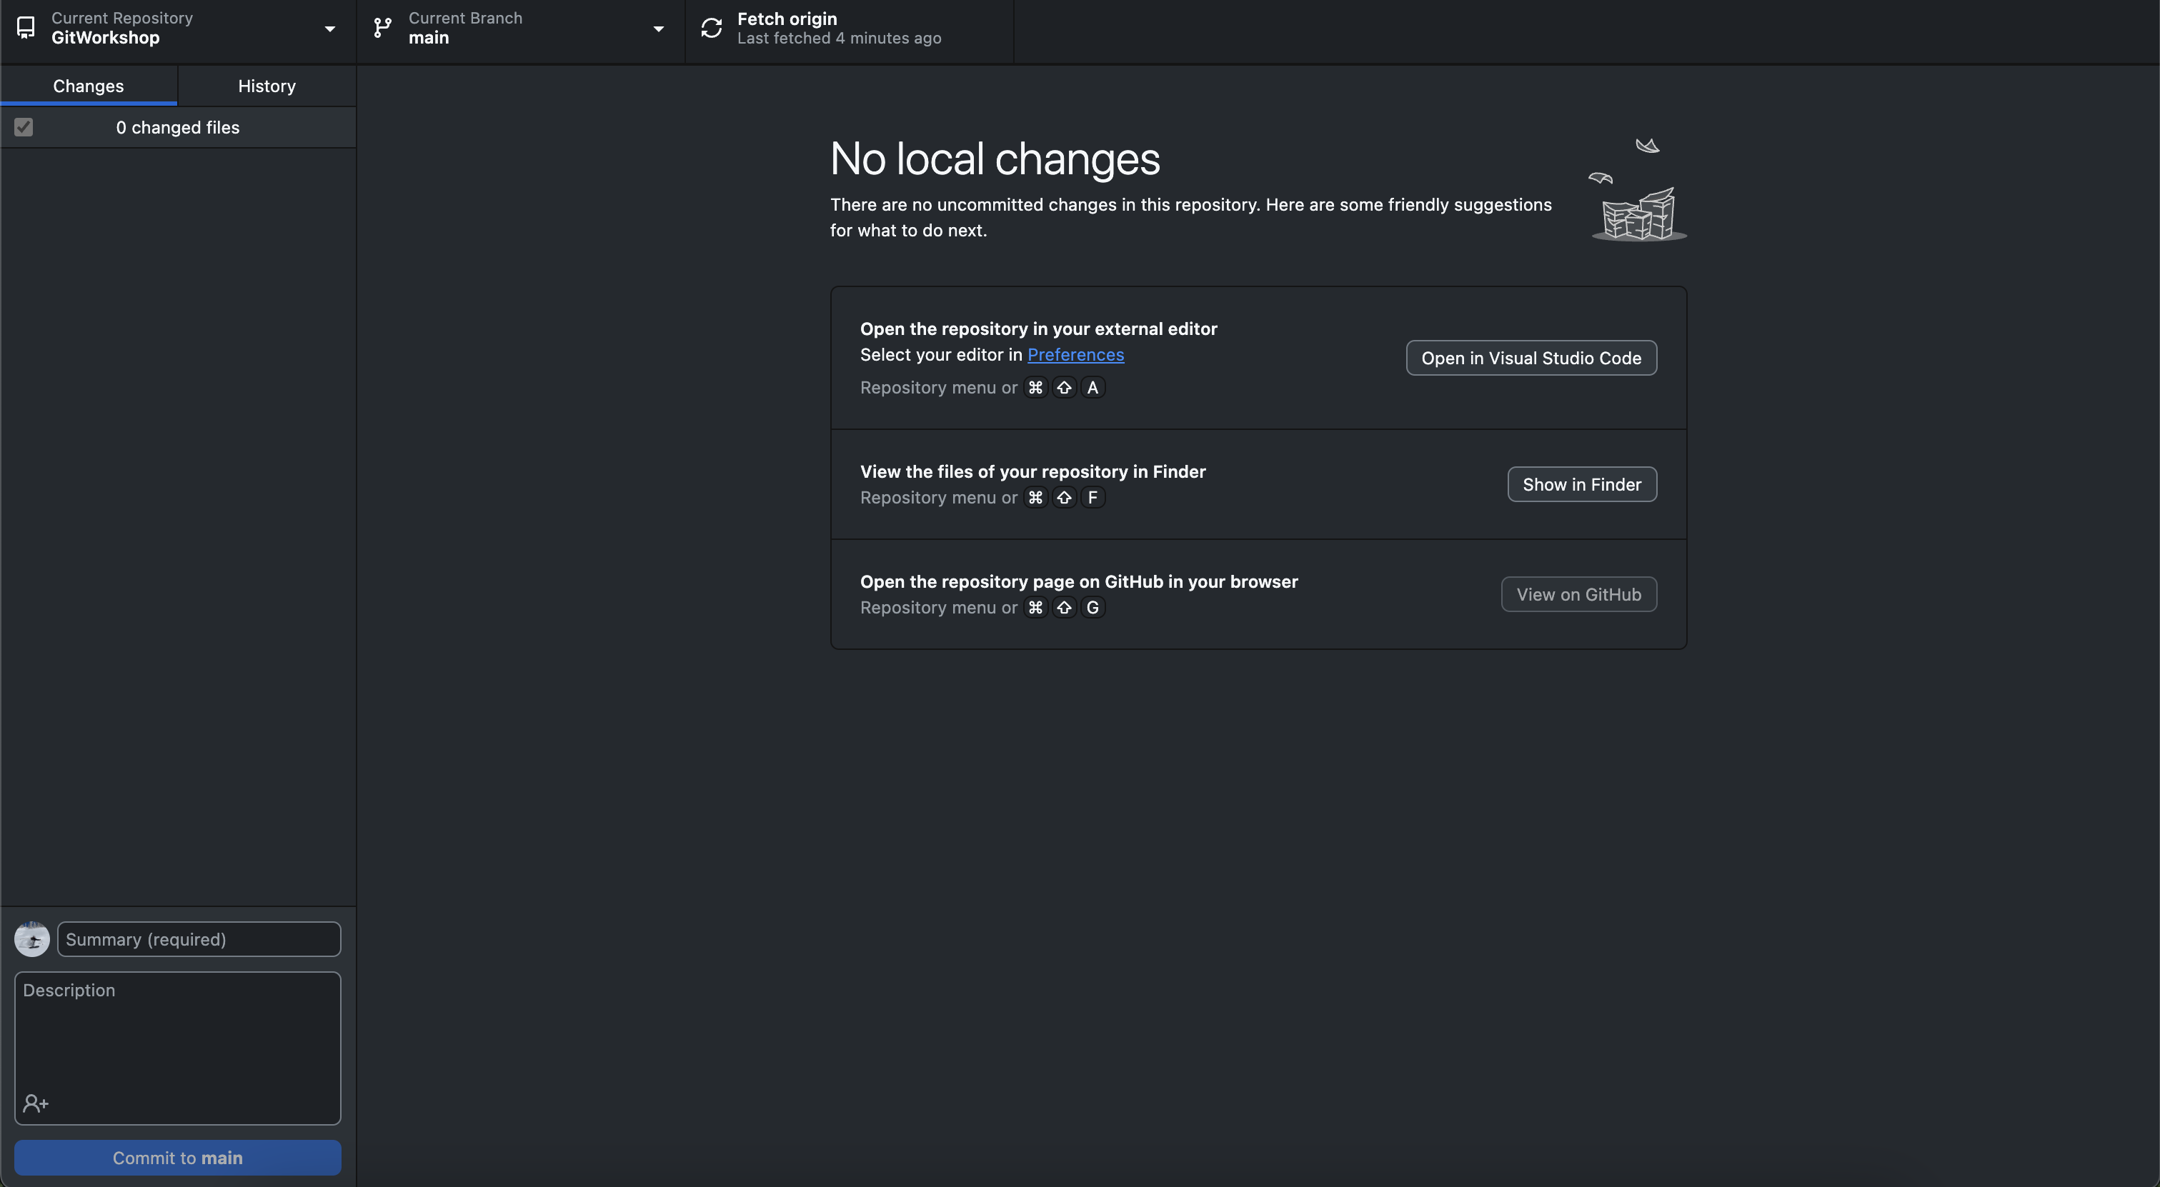
Merge Conflicts and Branch Control: Example
Merging one branch into another in GitHub Desktop:
Make sure you have the branch you wish to merge into checked out

Slide 39
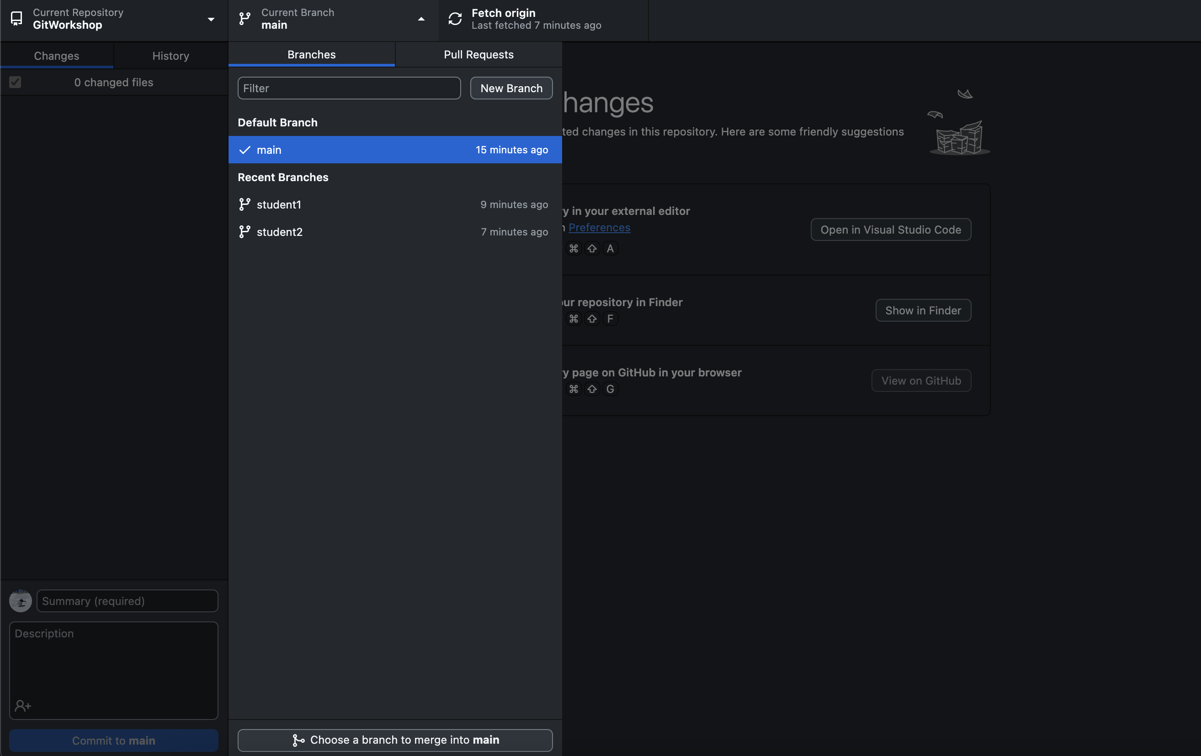
Merge Conflicts and Branch Control: Example
Merging one branch into another in GitHub Desktop:
2. Click “Choose a branch to merge into _____”

Slide 40
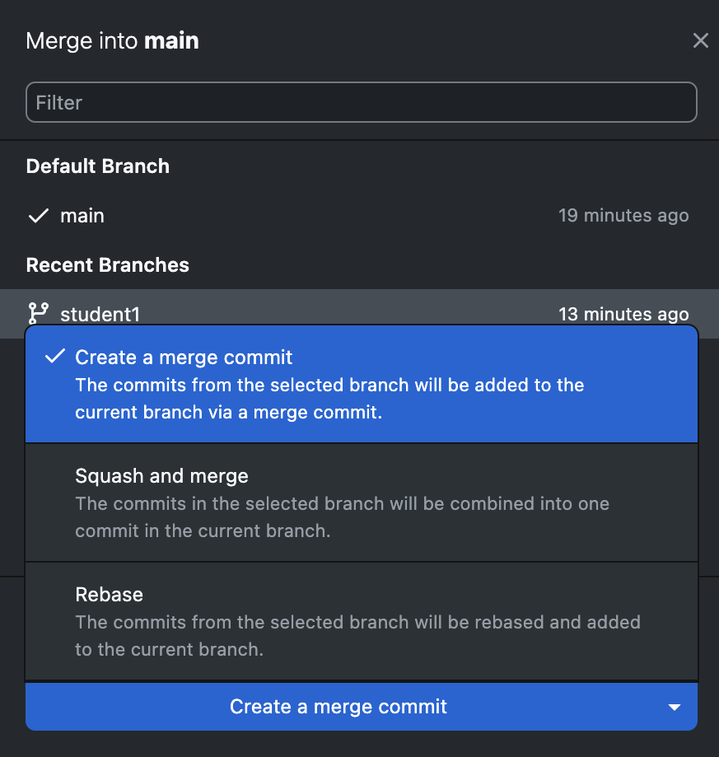
Merge Conflicts and Branch Control: Example
Merging one branch into another in GitHub Desktop:
Select the branch you wish to merge into the checked-out branch
You will have 3 options of merging:
Create a merge commit:
Standard merge conflict resolution when merging selected branch into main
Useful if don’t have a lot of new commits on selected branch
Squash and merge:
All new commits on selected branch are combined into 1, then pushed to main
Recommended if selected branch has a lot of new commits
Rebase:
Individually commits history of selected branch into main
Not recommended for most applications, too many commits is hard to read and understand

Slide 41
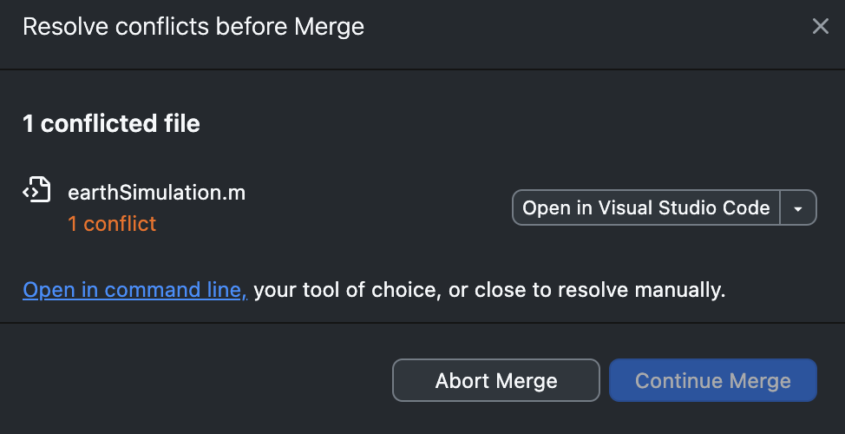
Merge Conflicts and Branch Control: Example
Merging one branch into another in GitHub Desktop:
4. Merge conflict
If there are merge conflicts, will get this display:
Can either manage merge conflicts in a IDE (such as VSCode)
Or can select version from specific branch

Slide 42
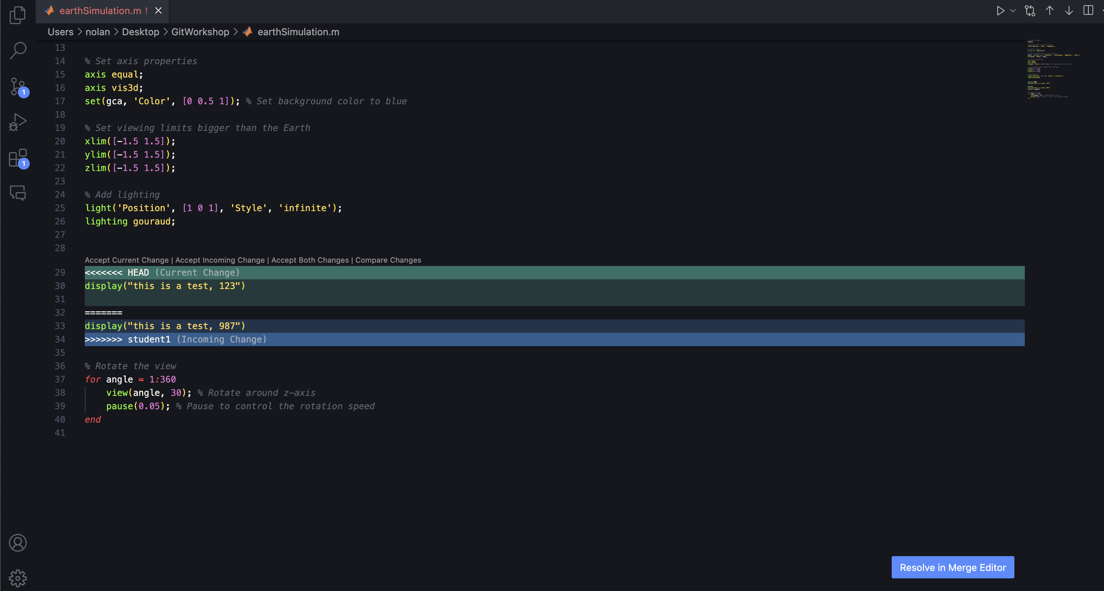
Merge Conflicts and Branch Control: Example
Merging one branch into another in GitHub Desktop:
4a. Merge conflict in VSCode (or other IDE):
The “HEAD” is the code from branch you wish to merge into (ex: main)
The ”Incoming Change” is the code from the branch you are merging into the HEAD (ex: student1)
Can choose to accept either version or both

Slide 43
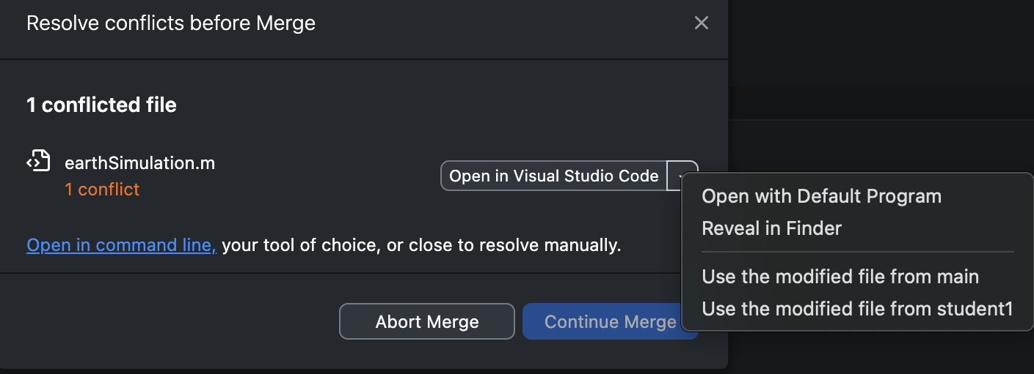
Merge Conflicts and Branch Control: Example
Merging one branch into another in GitHub Desktop:
4b. Merge conflict, force merging
If you just want the entire file from a branch and don’t want to deal with merge conflicts
Can select which branch you want to take the file from
Nothing from the other branch will be updated
Very common use and easy to avoid merge conflicts
Note: when dealing with merge conflicts on a branch sometimes you will see ”origin/___”
Origin simply means the version that is on the GitHub repository (can check what’s on this branch by going on github.com) - typically means the prior version of project

Slide 44
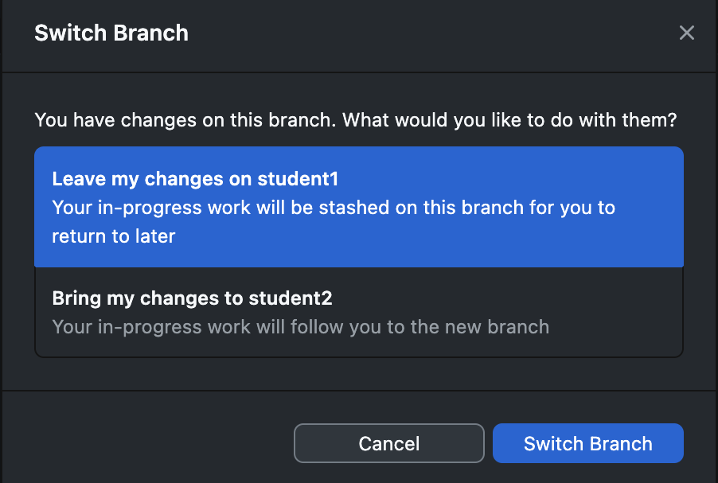
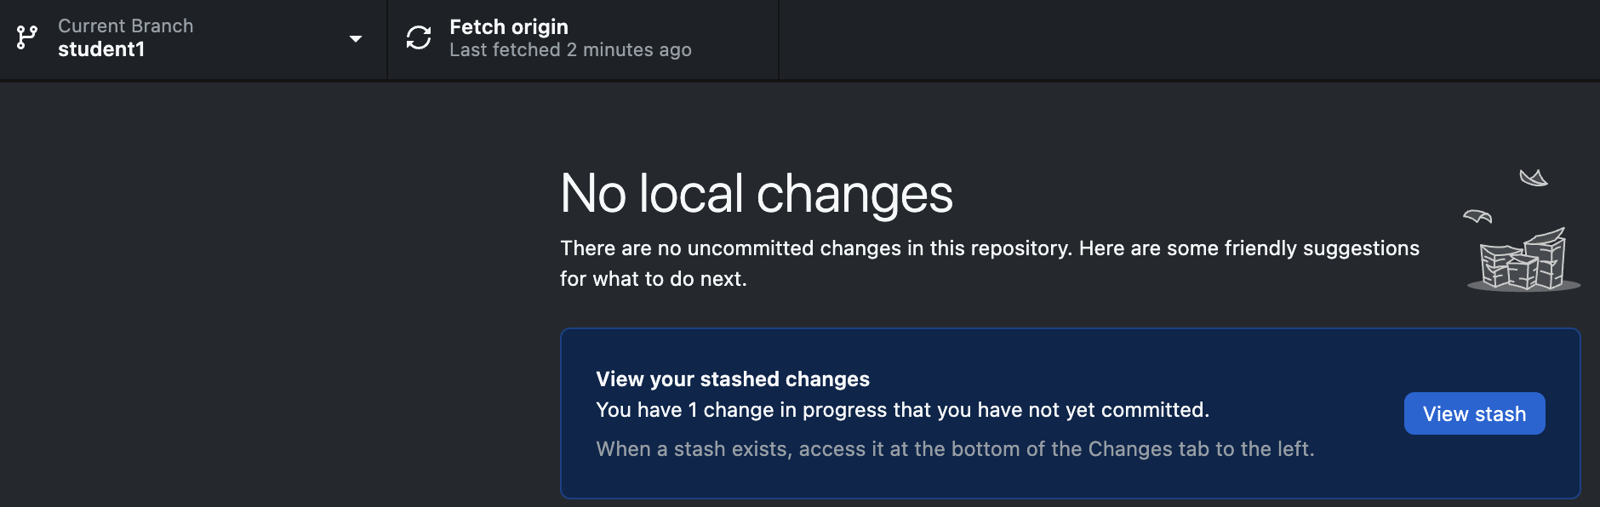
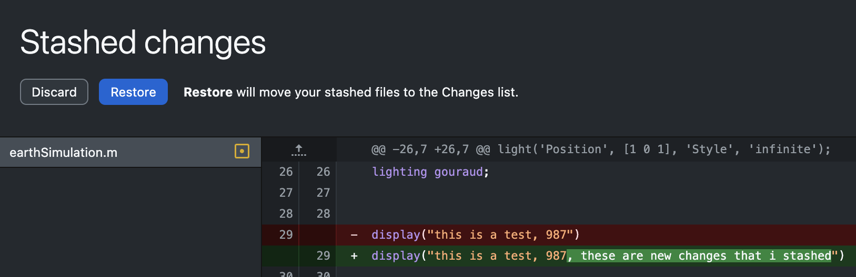
Branch Control: Switching Branches
Sometimes you want to look at the code on another branch
GitHub Desktop allows for easy switching of branches, but, you have to be careful!
If you have uncommitted changes, highly recommended you stash them:
”Leave my changed on ____” stashes the changes
Otherwise, you may have to deal with merge conflict if you “bring your changes”
Your stash will still be waiting for you when you switch back

Slide 45
Sources and More information
https://git-scm.com/about
https://www.atlassian.com/git/tutorials/using-branches/merge-conflicts
https://github.com/

